Slide 1

Join on GPUs
10/23/2023
Ahmedur Rahman Shovon
PhD student
Department of Computer Science
Email: ashov@uic.edu
Website: arshovon.com

Slide 2
Roadmap
Introduction to GPU
GPGPU
Recap to Join operation
Parallel join
Off-the-shelf parallel join
Parallel hash join

Slide 3
Introduction to GPU

Slide 4
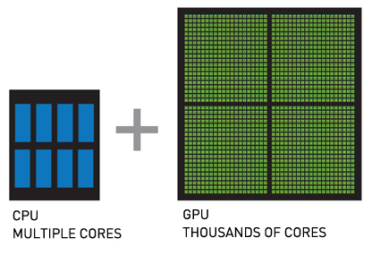
GPU
Graphics processing unit (GPU) accelerates graphics and data processing
Work together with CPU
GPU is designed for parallel processing
Use cases:
Graphics and video rendering
Gaming
Machine learning, AI, Deep learning
Scientific computing
Major manufacturers: Nvidia, AMD, Intel
Host
Device

Slide 5
Advancements in GPU
1970s - 1980s
Basic 2D graphics rendering
1990s
3D graphics accelerators
Early 2000s
Programmable shaders
Parallel processing on GPU
Late 2010s - Early 2020s
AI / ML acceleration
Mid 2000s

Slide 6
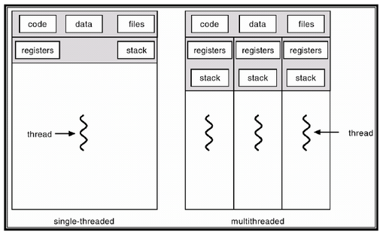
CPU vs GPU (A Sample Machine)
CPU
13th Gen Intel® Core™ i9-13900H
14 cores (6 P-cores + 8 E-cores)
Total 20 threads
Suitable for serial workloads
Access to system memory (RAM)
GPU
NVIDIA GeForce RTX 4070, 8 GB GDDR6
5888 CUDA cores
Total 94,208 threads
Suitable for parallel workloads
Access to dedicated VRAM

Slide 7
GPGPU

Slide 8
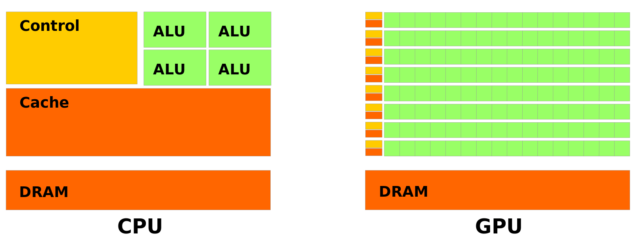
GPGPU
General Purpose computing using GPU
Influenced the scientific computing paradigms
Offers thousands of cores
Power efficiency TFlop per Watt
File:Cpu-gpu.svg. (2020, October 1). Wikimedia Commons. Retrieved 18:08, April 10, 2023 from https://commons.wikimedia.org/w/index.php?title=File:Cpu-gpu.svg&oldid=477433509.
Levinas, M. (2020, November). What is GPU computing and how is it applied today? What Is GPU Computing And How Is It Applied Today? Retrieved from https://blog.cherryservers.com/what-is-gpu-computing
Notes:
General Purpose computing using GPU for parallel independent calculations
Became popular in the mid-2000s
Influenced the High-Performance Computing paradigms
Performance: offers thousands of cores
Power efficiency: in terms of TFlop per Watt

Slide 9
Massive parallel processing: Scientific simulations
Efficient large dataset handling: Machine learning algorithms
Real-time processing: Gaming and streaming
Accelerated financial modeling: Risk assessment and pricing
GPGPU Advantages

Slide 10
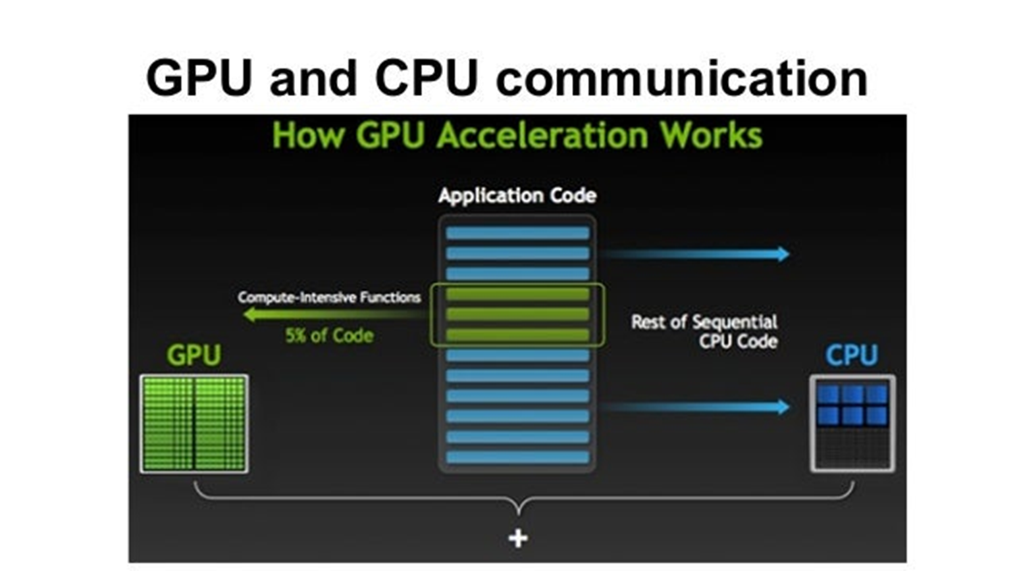
GPU Programming Model
CUDA - proprietary to Nvidia GPUs but most mature and established
HIP - targets AMD GPUs
SYCL - open standard for cross-platform portability
DPC++ - Intel's implementation of SYCL
OneAPI - Intel's unified programming model across devices

Slide 11
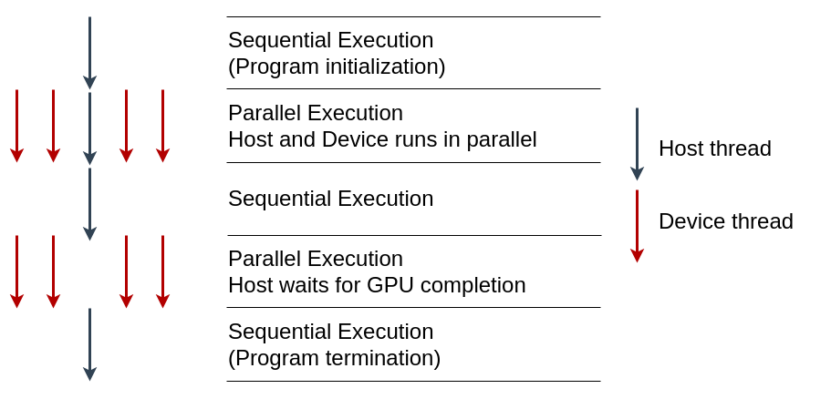
CUDA Programming Model
Globally Sequential Locally Parallel programming pattern
Invokes parallel kernels that execute across a set of threads
CUDA spawns the threads from a hierarchy of grid (3D) and block (3D)
Each thread executes an instance of the kernel
Supports C/C++, Fortan, Python
Jason. Sanders. CUDA by example : an introduction to general-purpose GPU programming. Addison-Wesley, Upper Saddle River, NJ, 2011.
Jianbin Fang, Chun Huang, Tao Tang, and Zheng Wang. Parallel programming models for heterogeneous many-cores: a comprehensive survey. CCF Transactions on High Performance Computing, 2(4):382–400, 2020.

Slide 12
GPGPU Challenges
Algorithm adaptation for GPU: Sequential to parallel
Parallelism synchronization: Putting barrier
Memory management: Host to device and device to host data transfer
Portability: Portability to different GPU devices
Gerassimos Barlas. Chapter 6 - gpu programming. In Gerassimos Barlas, editor, Multicore and GPU Programming, pages 391–526. Morgan Kaufmann, Boston, 2015.
J. D. Owens, M. Houston, D. Luebke, S. Green, J. E. Stone and J. C. Phillips, "GPU Computing," in Proceedings of the IEEE, vol. 96, no. 5, pp. 879-899, May 2008, doi: 10.1109/JPROC.2008.917757.

Slide 13
Recap to Join operation

Slide 14
Recap to Relational Data
Relation
Relation: 2-dimensional structure
Attribute: Represents characteristics
Row: Represents unique record
Join (⨝): Combines data from relations
Projection (Π): Select specific columns
UserID | UserName | UserEmail
101 | Alice | alice@example.com
102 | Bob | bob@example.com
Tuple
(Row)
Attribute (Column)
Sidharth Kumar and Thomas Gilray. Distributed relational algebra at scale. In International Conference on High Performance Computing, Data, and Analytics (HiPC). IEEE, 2019.
Sidharth Kumar and Thomas Gilray. Load-balancing parallel relational algebra. In International Conference on High Performance Computing, pages 288–308. Springer, 2020.

Slide 15
Why Join is Important?
Combine data from multiple tables
Find patterns in data
Clean data
Create new data sets
Daniel Zinn, Haicheng Wu, Jin Wang, Molham Aref, and Sudhakar Yalamanchili. General-purpose join algorithms for large graph triangle listing on heterogeneous systems. In Proceedings of the 9th Annual Workshop on General Purpose Processing Using Graphics Processing Unit, pages 12–21, 2016.

Slide 16
Example of Natural Join ⨝
User
UserID | UserName | UserEmail
101 | Alice | alice@example.com
102 | Bob | bob@example.com
103 | Eve | eve@example.com
⨝
Order
UserID | OrderTotal | Items
101 | 25.69 | 2
102 | 145.66 | 3
103 | 12.11 | 1
103 | 44.00 | 2

Slide 17
Example of Natural Join ⨝
User
UserID | UserName | UserEmail
101 | Alice | alice@example.com
102 | Bob | bob@example.com
103 | Eve | eve@example.com
⨝
User
Order
⨝
UserID | UserName | UserEmail | OrderTotal | Items
101 | Alice | alice@example.com | 25.69 | 2
102 | Bob | bob@example.com | 145.66 | 3
103 | Eve | eve@example.com | 12.11 | 1
101 | Alice | alice@example.com | 44.00 | 2
Order
UserID | OrderTotal | Items
101 | 25.69 | 2
102 | 145.66 | 3
103 | 12.11 | 1
103 | 44.00 | 2

Slide 18
Example of Natural Join ⨝
User
UserID | UserName | UserEmail
101 | Alice | alice@example.com
102 | Bob | bob@example.com
103 | Eve | eve@example.com
⨝
User
Order
⨝
UserID | UserName | UserEmail | OrderTotal | Items
101 | Alice | alice@example.com | 25.69 | 2
102 | Bob | bob@example.com | 145.66 | 3
103 | Eve | eve@example.com | 12.11 | 1
101 | Alice | alice@example.com | 44.00 | 2
Order
UserID | OrderTotal | Items
101 | 25.69 | 2
102 | 145.66 | 3
103 | 12.11 | 1
103 | 44.00 | 2

Slide 19
Example of Natural Join ⨝
User
UserID | UserName | UserEmail
101 | Alice | alice@example.com
102 | Bob | bob@example.com
103 | Eve | eve@example.com
⨝
User
Order
⨝
UserID | UserName | UserEmail | OrderTotal | Items
101 | Alice | alice@example.com | 25.69 | 2
102 | Bob | bob@example.com | 145.66 | 3
103 | Eve | eve@example.com | 12.11 | 1
101 | Alice | alice@example.com | 44.00 | 2
Order
UserID | OrderTotal | Items
101 | 25.69 | 2
102 | 145.66 | 3
103 | 12.11 | 1
103 | 44.00 | 2

Slide 20
Example of Natural Join ⨝
User (Outer Relation)
UserID | UserName | UserEmail
101 | Alice | alice@example.com
102 | Bob | bob@example.com
103 | Eve | eve@example.com
⨝
User
Order
⨝
UserID | UserName | UserEmail | OrderTotal | Items
101 | Alice | alice@example.com | 25.69 | 2
102 | Bob | bob@example.com | 145.66 | 3
103 | Eve | eve@example.com | 12.11 | 1
103 | Eve | eve@example.com | 44.00 | 2
Order (Inner Relation)
UserID | OrderTotal | Items
101 | 25.69 | 2
102 | 145.66 | 3
103 | 12.11 | 1
103 | 44.00 | 2

Slide 21
Example of Natural Join ⨝
User (Outer Relation)
UserID | UserName | UserEmail
101 | Alice | alice@example.com
102 | Bob | bob@example.com
103 | Eve | eve@example.com
⨝
User
Order
⨝
UserID | UserName | UserEmail | OrderTotal | Items
101 | Alice | alice@example.com | 25.69 | 2
102 | Bob | bob@example.com | 145.66 | 3
103 | Eve | eve@example.com | 12.11 | 1
103 | Eve | eve@example.com | 44.00 | 2
Order (Inner Relation)
UserID | OrderTotal | Items
101 | 25.69 | 2
102 | 145.66 | 3
103 | 12.11 | 1
103 | 44.00 | 2

Slide 22
Duplicates on Join Result
User ⨝ Order
UserID | UserName | UserEmail | OrderTotal | Items
101 | Alice | alice@example.com | 25.69 | 2
102 | Bob | bob@example.com | 145.66 | 3
103 | Eve | eve@example.com | 12.11 | 1
103 | Eve | eve@example.com | 44.00 | 2
Π(_{UserName,UserEmail})(User ⨝ Order)
UserName | UserEmail
Alice | alice@example.com
Bob | bob@example.com
Eve | eve@example.com
Eve | eve@example.com

Slide 23
Parallel Join

Slide 24
How can we do join in parallel?
Order (Inner Relation)
User (Outer Relation)
UserID | OrderTotal | Items
101 | 25.69 | 2
102 | 145.66 | 3
103 | 12.11 | 1
103 | 44.00 | 2
UserID | UserName | UserEmail
101 | Alice | alice@example.com
102 | Bob | bob@example.com
103 | Eve | eve@example.com
⨝

Slide 25
Parallel Join ⨝
Order (Inner Relation)
User (Outer Relation)
UserID | OrderTotal | Items
101 | 25.69 | 2
102 | 145.66 | 3
103 | 12.11 | 1
103 | 44.00 | 2
UserID | UserName | UserEmail
101 | Alice | alice@example.com
102 | Bob | bob@example.com
103 | Eve | eve@example.com
⨝
Thread 1
Thread 2
All executing in parallel
Thread 3

Slide 26
Parallel Join
What: Perform relational join operation simultaneously on a number of processors or machines
When: Useful when input data is enormous and the join is computationally costly
How: Divide the data into partitions and assign each partition to a different processor
Daniel Zinn, Haicheng Wu, Jin Wang, Molham Aref, and Sudhakar Yalamanchili. General-purpose join algorithms for large graph triangle listing on heterogeneous systems. In Proceedings of the 9th Annual Workshop on General Purpose Processing Using Graphics Processing Unit, pages 12–21, 2016.

Slide 27
Off-the-shelf Parallel Join

Slide 28
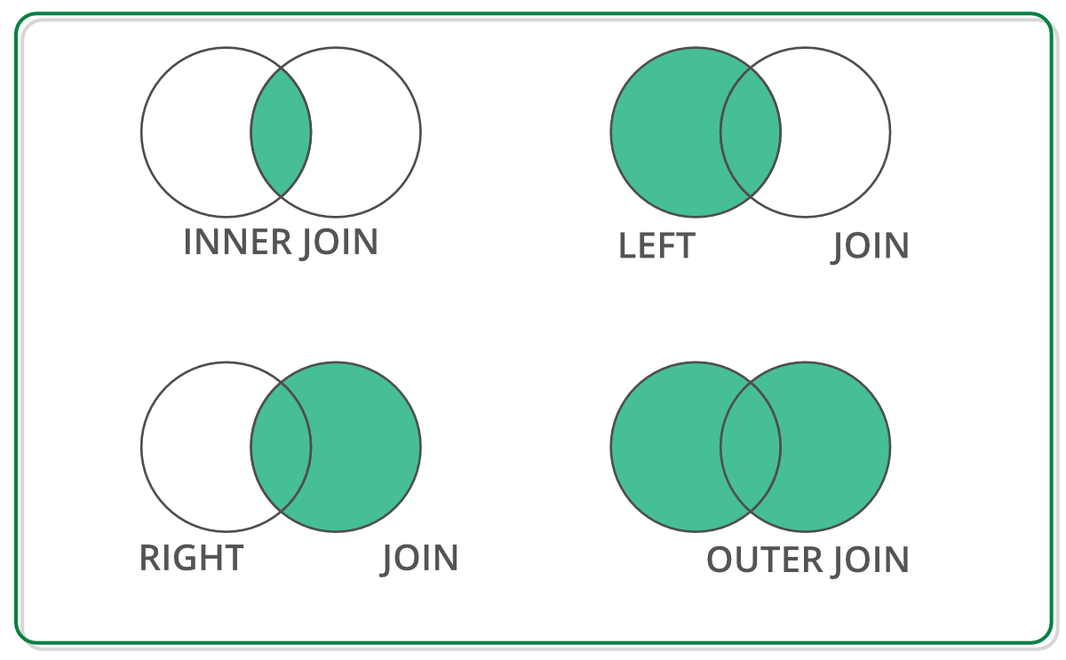
Off-the-shelf Data Structure for Join Operation
DataFrame has RA primitives APIs
DataFrame: 2D labeled tabular data structure
Reback, J., McKinney, W., Van Den Bossche, J., Augspurger, T., Cloud, P., Klein, A., ... & Seabold, S. (2020). pandas-dev/pandas: Pandas 1.0. 5. Zenodo.
Chen, D. Y. (2017). Pandas for everyone: Python data analysis. Addison-Wesley Professional.
Singh, R. (2020, July 1). Merging DataFrames with Pandas: Pd.merge(). Medium. Retrieved April 8, 2023, from https://medium.com/swlh/merging-dataframes-with-pandas-pd-merge-7764c7e2d46d

Slide 29


Off-the-shelf Python Libraries
DataFrame: 2D labeled tabular data structure
GPU (NVIDIA cuDF)
CPU
Both supports join operation with similar APIs
Reback, J., McKinney, W., Van Den Bossche, J., Augspurger, T., Cloud, P., Klein, A., ... & Seabold, S. (2020). pandas-dev/pandas: Pandas 1.0. 5. Zenodo.
Chen, D. Y. (2017). Pandas for everyone: Python data analysis. Addison-Wesley Professional.
Green, O., Du, Z., Patel, S., Xie, Z., Liu, H., & Bader, D. A. (2021, December). Anti-Section Transitive Closure. In 2021 IEEE 28th International Conference on High Performance Computing, Data, and Analytics (HiPC) (pp. 192-201). IEEE.
Fender, A., Rees, B., & Eaton, J. RAPIDS cuGraph. In Massive Graph Analytics (pp. 483-493). Chapman and Hall/CRC.

Slide 30
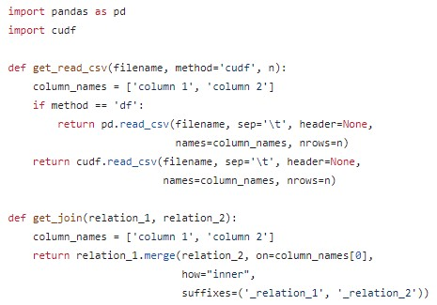
CPU (Pandas) and GPU (cuDF)
CPU Environment
GPU Environment
https://github.com/harp-lab/GPUJoin/edit/main/IA3_2022/basic_operations.py

Slide 31
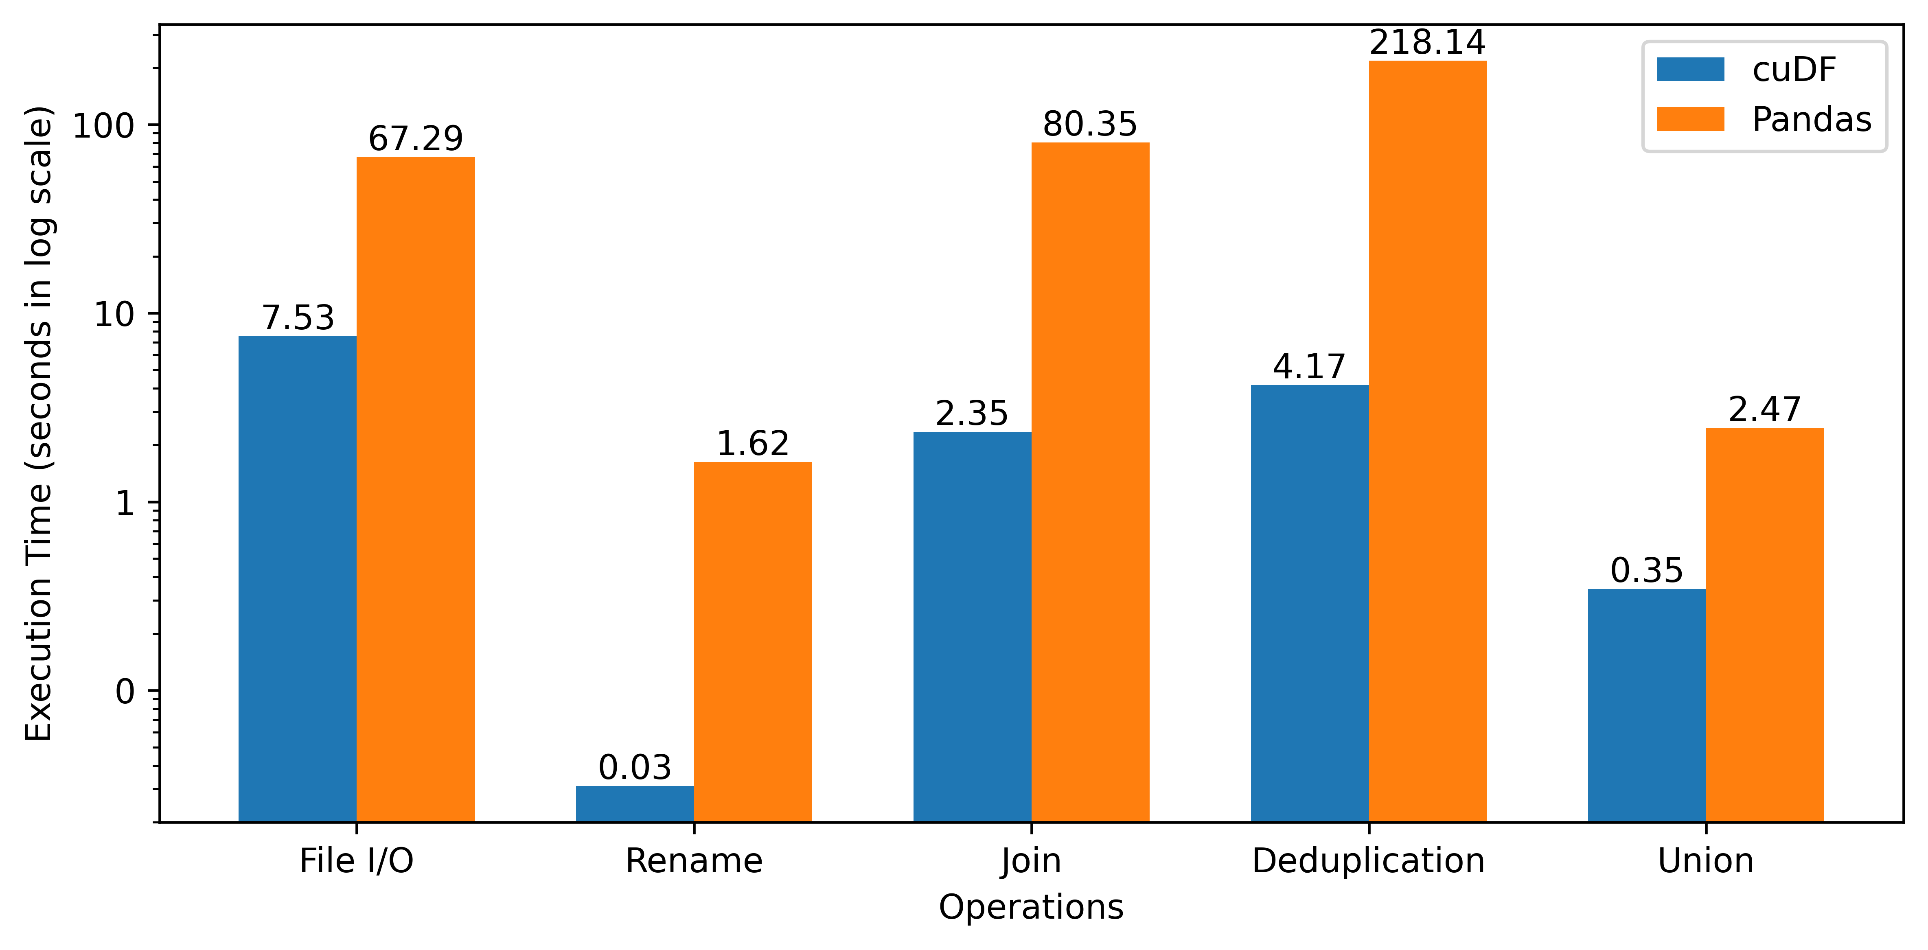
Performance Improvement of using GPU
https://github.com/harp-lab/GPUJoin/edit/main/IA3_2022/basic_operations.py

Slide 32
Parallel Hash Join

Slide 33
Parallel Join: Algorithms
Popular algorithms
Sort-Merge Join (SMJ)
Hash Join (HJ)
SMJ is suitable for small to medium-sized tables HJ is suitable for large tables
Chengxin Guo, Hong Chen, Feng Zhang, and Cuiping Li. Parallel hybrid join algorithm on gpu. 2019IEEE 21st International Conference on High Performance Computing and Communications; IEEE17th International Conference on Smart City; IEEE 5th International Conference on Data Science andSystems (HPCC/SmartCity/DSS), pages 1572–1579, 2019.
Hongzhi Wang, Ning Li, Zheng ke Wang, and Jianing Li. Gpu-based efficient join algorithms on hadoop.The Journal of Supercomputing, 77:292 – 321, 2020.

Slide 34
Hash Join Process
Outer
Relation
Hash Table
35
44
11
23
11
23
. . .
. . .
46
31
46
31
. . .
97
32
35
44
Key - Value
97
32
Key - Value

Slide 35
Hash Join Process
Hash Join Relation
With
Duplicate records
Hash Join Relation
With
Duplicate records
Hash Join Relation
Without
Duplicate records
⨝
Hash Table
Inner
Relation
Deduplication

Slide 36
Hash Table (Open Addressing, Linear Probing)
Grid Stride Loop
0
1
...
511
. . .
Block 0
35
44
11
23
. . .
. . .
0
1
...
511
46
31
. . .
Block n
97
32
CUDA Threads
Key - Value
Hash Table
Key-Value Pair

Slide 37
Hash Table (Open Addressing, Linear Probing)
Grid Stride Loop
Murmur 3 hashing
0
1
...
511
35
44
. . .
Block 0
35
44
11
23
11
23
. . .
. . .
0
1
...
511
AtomicCAS
46
31
. . .
Block n
97
32
CUDA Threads
Key - Value
Hash Table
Key-Value Pair

Slide 38
Hash Table (Open Addressing, Linear Probing)
Grid Stride Loop
Murmur 3 hashing
0
1
...
511
35
44
. . .
Block 0
35
44
11
23
11
23
. . .
. . .
0
1
...
511
AtomicCAS
46
31
. . .
Block n
97
32
CUDA Threads
Key - Value
Hash Table
Key-Value Pair

Slide 39
Hash Table (Open Addressing, Linear Probing)
Grid Stride Loop
Murmur 3 hashing
0
1
...
511
35
44
. . .
Block 0
35
44
11
23
11
23
. . .
. . .
0
1
...
511
AtomicCAS
46
31
. . .
Block n
97
32
CUDA Threads
Key - Value
Hash Table
Key-Value Pair

Slide 40
Hash Table (Open Addressing, Linear Probing)
Grid Stride Loop
Murmur 3 hashing
0
1
...
511
35
44
. . .
Block 0
35
44
11
23
11
23
. . .
. . .
0
1
...
511
AtomicCAS
46
31
. . .
Block n
97
32
Collision -> Linear probing (Position + 1) & hash table size
CUDA Threads
Key - Value
Hash Table
Key-Value Pair

Slide 41
Hash Table (Open Addressing, Linear Probing)
Grid Stride Loop
Murmur 3 hashing
0
1
...
511
35
44
. . .
Block 0
35
44
11
23
11
23
. . .
. . .
0
1
...
511
AtomicCAS
46
31
. . .
Block n
46
31
97
32
Collision -> Linear probing (Position + 1) & hash table size
97
32
CUDA Threads
Key - Value
Hash Table
Key-Value Pair

Slide 42
Performing Hash Join on GPU
Static Hash Table
Inner Relation
Key | Value
Key | Value
Calculate join size
⨝
First pass

Slide 43
Performing Hash Join on GPU
Static Hash Table
Inner Relation
Key | Value
Key | Value
Calculate join size
⨝
First pass
Prefix sum
Join Result
Second pass
(fused projection)
Join Key | Value 1 | Value 2

Slide 44
Performing Hash Join on GPU
Static Hash Table
Inner Relation
Key | Value
Key | Value
Calculate join size
⨝
First pass
Prefix sum
Join Result
Second pass
(fused projection)
Join Key | Value 1 | Value 2
Sort and Unique
Deduplicated Join Result
Key | Value

Slide 45
CUDA Advantages over cuDF
Fuse operations
Thread-block configuration
Memory management
Optimize data structure
Jason. Sanders. CUDA by example : an introduction to general-purpose GPU programming. AddisonWesley, Upper Saddle River, NJ, 2011.
John Cheng, Max Grossman, and Ty McKercher. Professional CUDA c programming. John Wiley & Sons, 2014

Slide 46
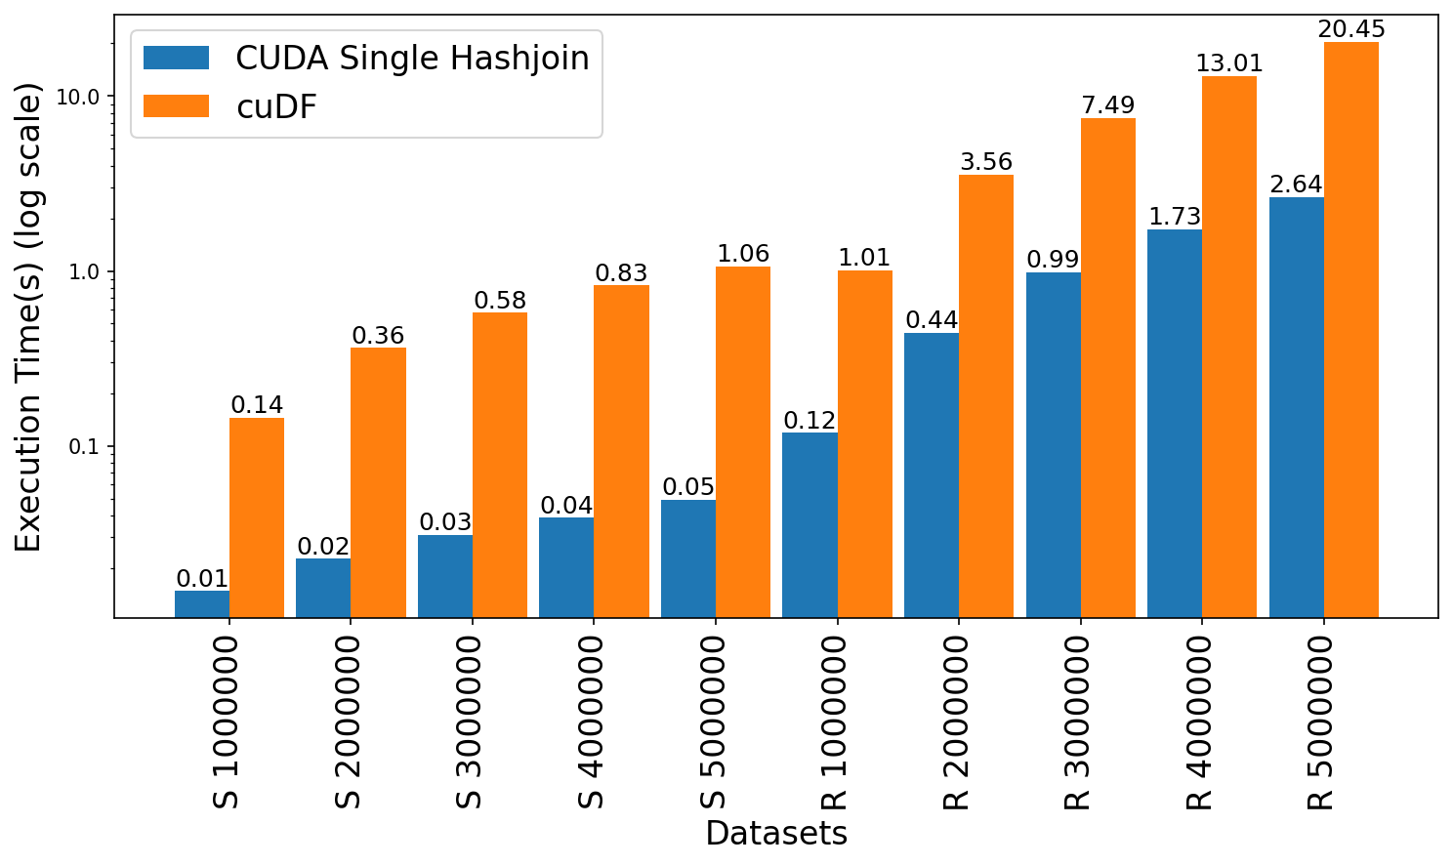
Join Performance Comparison: CUDA vs cuDF
Leadership Computing Facility, A. (2022). Argonne Leadership Computing Facility. Theta GPU Nodes. URL: https://www.alcf.anl.gov/support-center/theta-gpu-nodes
Notes:
Observe up to 21x speedup for string graph
Observe 7.6x to 8.4x speedup for random graph

Slide 47

Limitations
Limited to a single GPU that dictates scaling by available VRAM on the GPU
Memory overflow error for larger graphs
Open addressing based hash table causes memory overhead

Slide 48
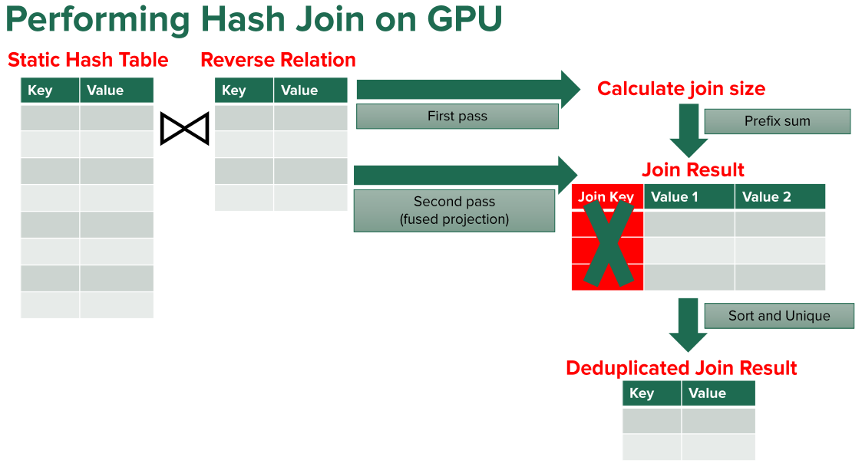
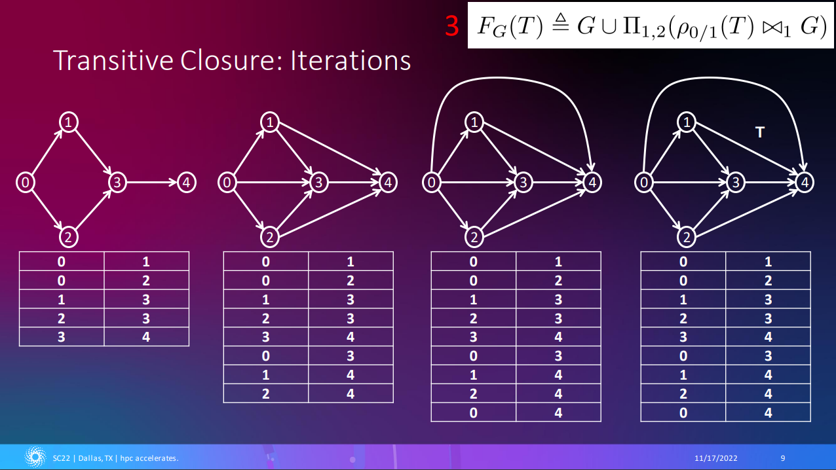
Publications
Shovon, A. R., Gilray, T., Micinski, K., & Kumar, S. (2023). Towards iterative relational algebra on the {GPU}. In 2023 USENIX Annual Technical Conference (USENIX ATC 23) (pp. 1009-1016).
Shovon, A. R., Dyken, L. R., Green, O., Gilray, T., & Kumar, S. (2022, November). Accelerating Datalog applications with cuDF. In 2022 IEEE/ACM Workshop on Irregular Applications: Architectures and Algorithms (IA3) (pp. 41-45). IEEE.

Slide 49
Summary
GPU provides performance enhancement
Python based cuDF can be a head start to GPU programming
Low level CUDA has a learning curve but improves performance

Slide 50
Thank You
ashov@uic.edu

